Slide 1
Game Changer ? / Water Swirled Into Gas Turbine Technology US Patent 8,671,696 , Second Ready to Issue and Third Pending !
Leonard M. Andersen / Water Swirled Into Gas Turbine Technology – IGTI TurboExpo Montreal Talked Of !
POB 1529 / NY, NY 10116 ($~1400 per year Caller box at Ex-GPO NY, NY) Most Secure Mail Service at Largest Post Office
914-536-7101 Cell Phone / / 914-237-7689 (H)
800-4284801
www.lenandersen.com
len@lenandersen.com ( HP SecureMail voltage connected )
water-gas-turbine@lenandersen.com

Slide 2
Electrical Generation New Combine Cycle US Patent 8,671,696 & Pending
The Technology is to have water into the hot end part of the gas turbine with the droplets of water traveling in a curved pattern after the combustion section. The biggest interest is with people of General Electric / Siemens / Shell / Saudi ARAMCO /. Words heard focus is on electrical generation in combined cycle mode !
Who – Engineer Member of IGTI ASME – STLE - AIChE - SPE for years / inventor noted in eleven patents.
What - combined cycle is a gas turbine front with a second turbine behind it. Currently it is a gas turbine with a steam boiler heated by hot “thrust gas“ of the turbine making steam that goes through a steam turbine. Best efficiency heard 64 %. The invention ( new tech ) is the hot thrust gas has water small droplet size etc mixed with said in a form that goes to steam quickly enough so that it enlarges said hot gases volume. The enlarged thrust gas flow makes an extractive turbine turn yielding lower capital cost and higher efficiency. Numbers gave me as improved efficiency fuel in electricity out are +12% gas fuel and14% liquid fuel .
When – Now ! Told Big International Concerns Combined Tech of Patent and Patents pending and confirmed 12- 14 % combined cycle plus. An airplane application gave +30 % !

Slide 5
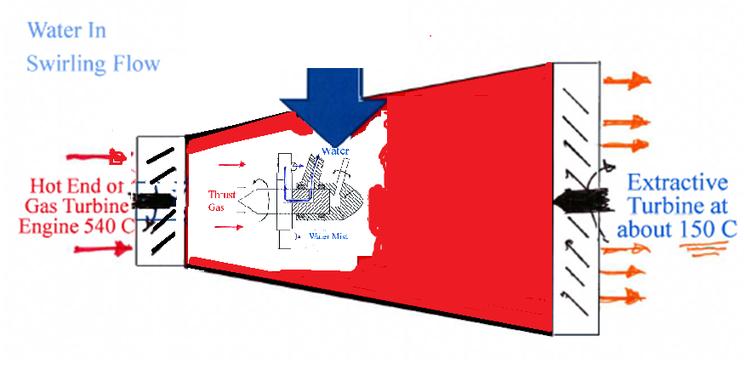
Steam Expansion Chamber

Slide 8
Plus Cheaper Electricity
The obvious is the more electricity out per unit of fuel in. The less obvious is efficiency of such less dependent on the size of electrical power generation plant. About the same for One to Five Hundred Mega Watt , therefore more plants less loss on electrical distribution. Less expensive faster start – shut down that steam turbine units !

Slide 9
Decision Factors
Twelve % gas – Fourteen % liquid up in fuel to electricity or mechanical energy output compared to combined cycle now in use. This would reduce carbon dioxide emissions by 12 – 14 % with additional emissions reduction with having less distance from electrical generation to electrical consumption.
Low capital cost combined cycle units, smaller and in greater numbers. Natural gas fields availabilities opens that possibility.
The efficiency of gas turbine electrical generator units 1 to 400 MW is nearly the same which would greatly reduce electrical distribution losses.
Use in transportation marine, train combined cycle gas turbines systems.
Lighter per KW capacity than some internal combustion systems.

Slide 11
Water Swirled Into Gas Turbine Technology – Thank You For Your Attention
Leonard M. Andersen Gas Turbine Engineer –AWS CWI ( Certified Welding Inspector ) len@lenandersen.com ( HP SecureMail voltage connected ) POB 1529 New York , New York 10116 ( $~1400 per year Caller Box Ex GPO NYC / Most Secure Service At Ex Largest Post Office USA )
914-536-7101 Cell Phone / 914-237-7689 Home / 800-428-4801 www.lenandersen.com – Residence 46 Alexander Avenue Yonkers NY

